Slide 2
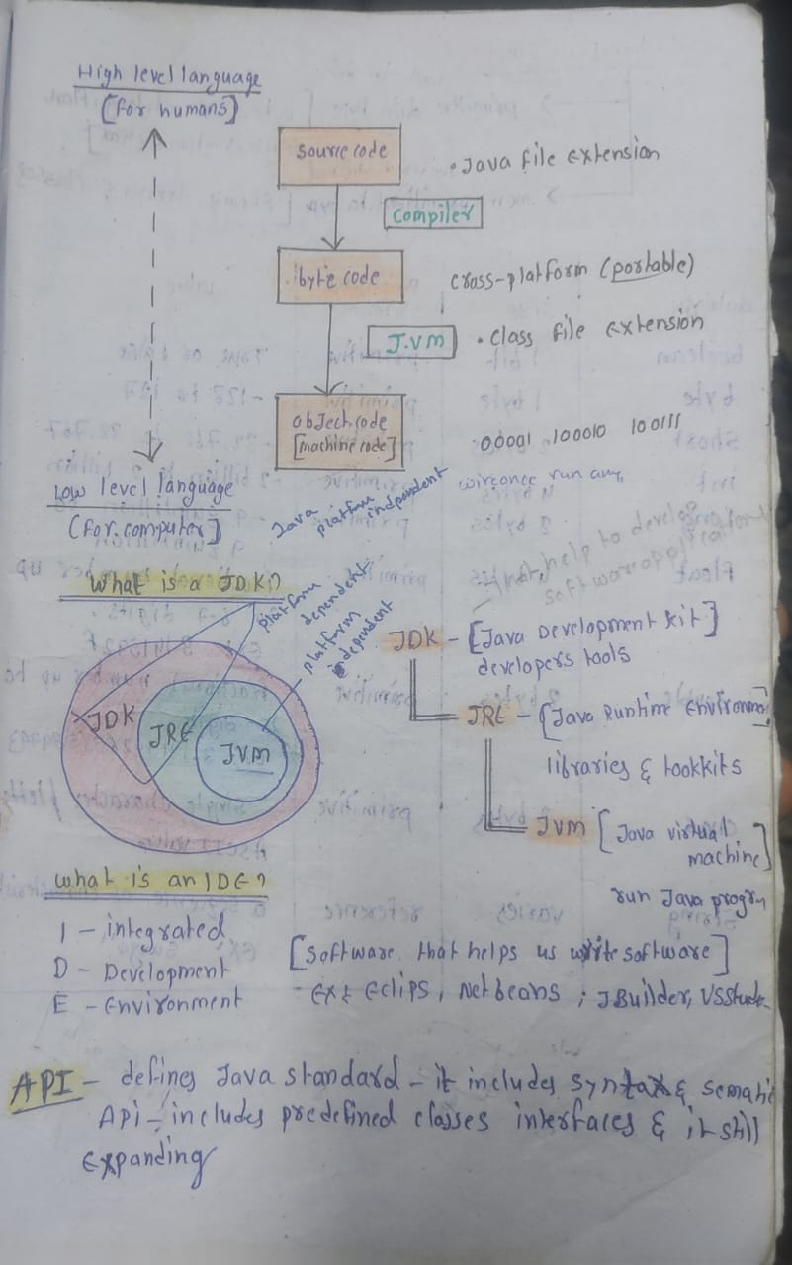

Slide 3
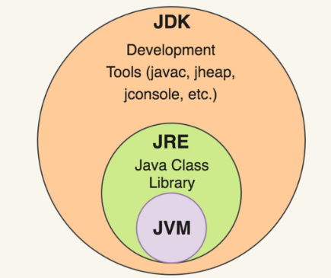

Slide 5
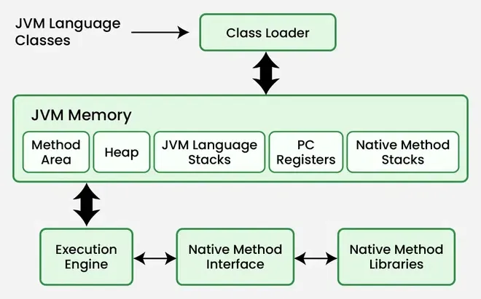

Slide 6
Data types are divided into two groups:
Primitive data types
Non-primitive data types

Slide 7
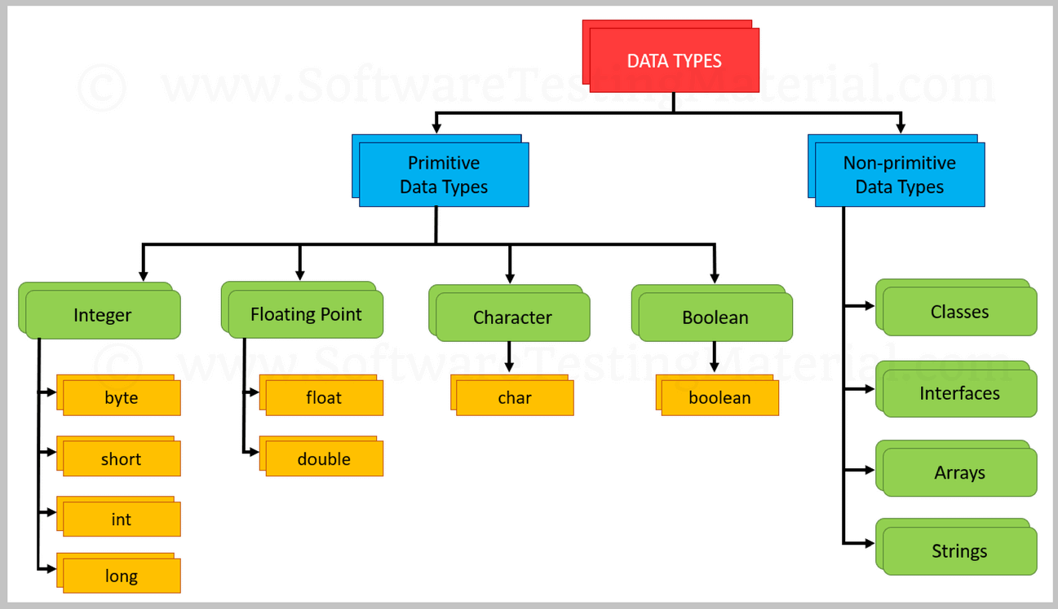

Slide 8
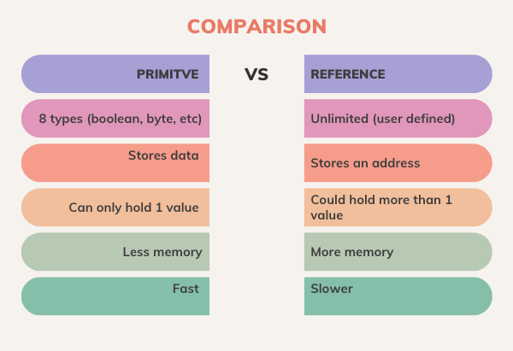

Slide 9
Java Variables
Variables are containers for storing data values.
In Java, there are different types of variables, for example:
String - stores text, such as "Hello". String values are surrounded by double quotes
int - stores integers (whole numbers), without decimals, such as 123 or -123
float - stores floating point numbers, with decimals, such as 19.99 or -19.99
char - stores single characters, such as 'a' or 'B'. Char values are surrounded by single quotes
boolean - stores values with two states: true or false

Slide 10
Java Operators
Operators are used to perform operations on variables and values.
Java divides the operators into the following groups:
Arithmetic operators
Assignment operators
Comparison operators
Logical operators
Bitwise operators

Slide 11
String Concatenation
Concatenation means joining two or more strings into one
.
Ways to concatenate strings in Java:
Using + operator
Using concat() method
Using StringBuilder / StringBuffer (for performance)

Slide 12
Using + Operator (most common)
public class StringPlusExample
{
public static void main(String[] args)
{
String first = "Hello";
String last = "World";
String full = first + " " + last;
System.out.println(full); // Hello World
}
}
When using +, Java creates a new String object because Strings are immutable.

Slide 13
Using concat() Method
public class StringConcatExample {
public static void main(String[] args) {
String s1 = "Java";
String s2 = "Programming";
String result = s1.concat(" ").concat(s2);
System.out.println(result); // Java Programming
}
}

Slide 14
Using StringBuilder (Best for loops or performance)
public class StringBuilderExample {
public static void main(String[] args) {
StringBuilder sb = new StringBuilder();
sb.append("Java");
sb.append(" ");
sb.append("Rocks!");
System.out.println(sb.toString()); // Java Rocks!
}
}

Slide 15
String API
The String API in Java means all the useful methods provided by the String class to work with text.
public class StringApiExample
{
public static void main(String[] args)
{
String name = " Surya Bhaskar ";
System.out.println(name.length()); // 17
System.out.println(name.trim()); // "Surya Bhaskar" (removes extra spaces)
System.out.println(name.toUpperCase()); // " SURYA BHASKAR "
System.out.println(name.toLowerCase()); // " surya bhaskar "
System.out.println(name.charAt(2)); // 'S'
System.out.println(name.contains("Bha")); // true
System.out.println(name.indexOf("a")); // 5
System.out.println(name.replace("a", "@")); // " Sury@ Bh@sk@r "
System.out.println(name.substring(2, 7)); // "Surya"
System.out.println(name.isEmpty()); // false
}
}

Slide 16
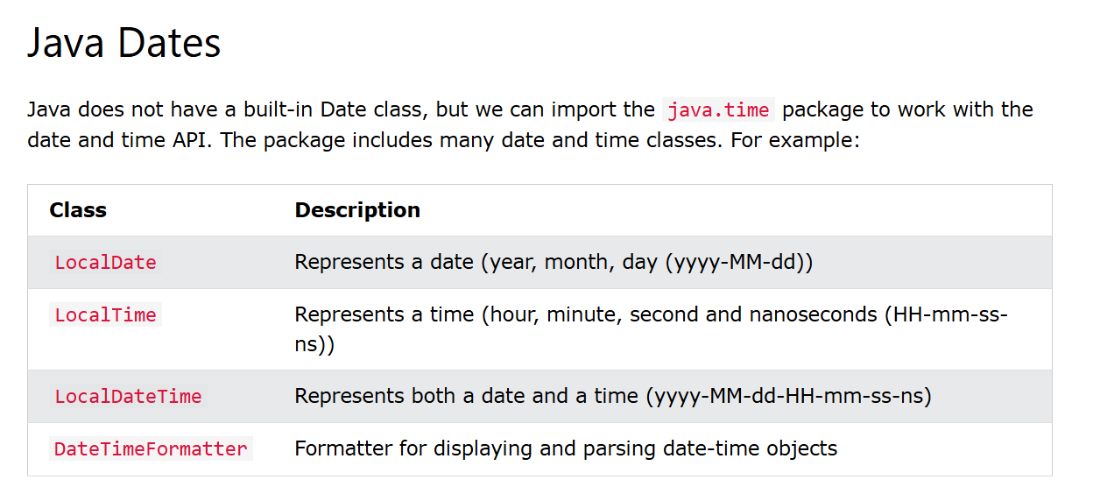

Slide 17
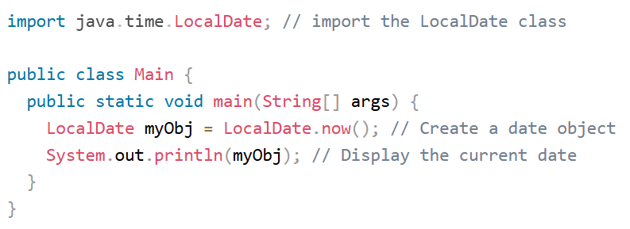

Slide 18
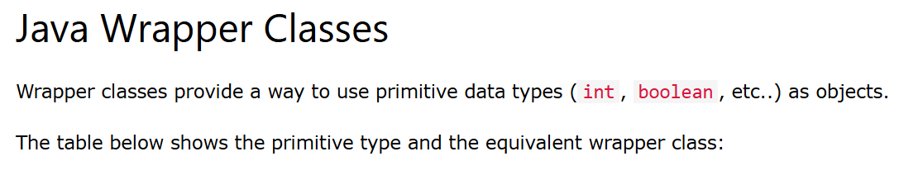
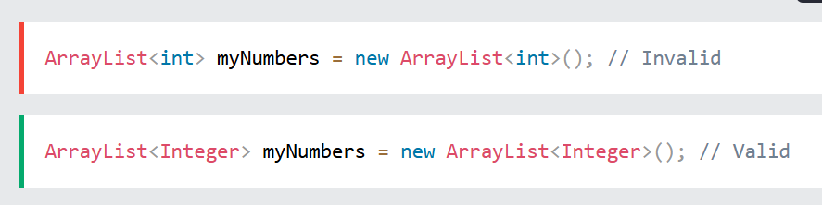

Slide 19
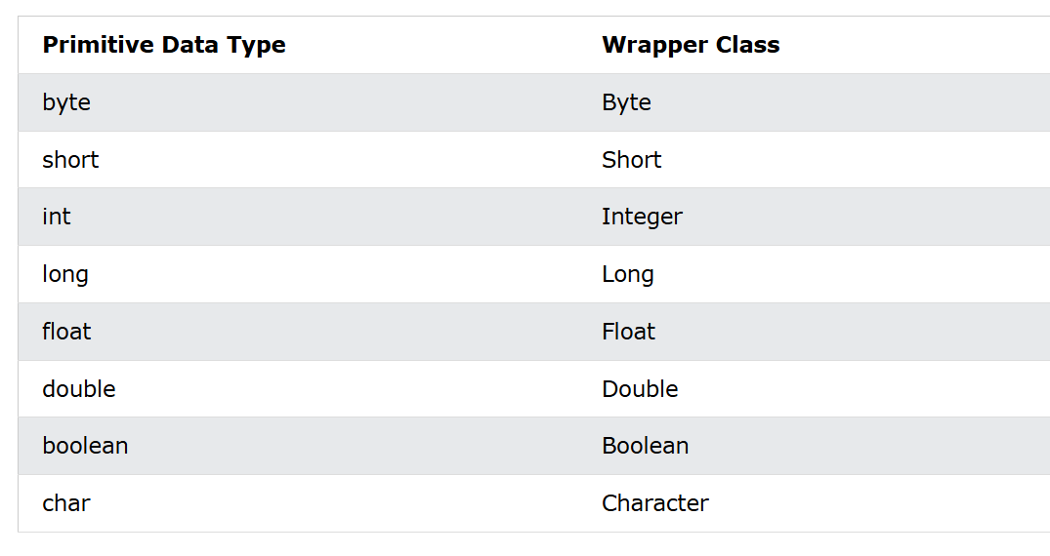

Slide 20
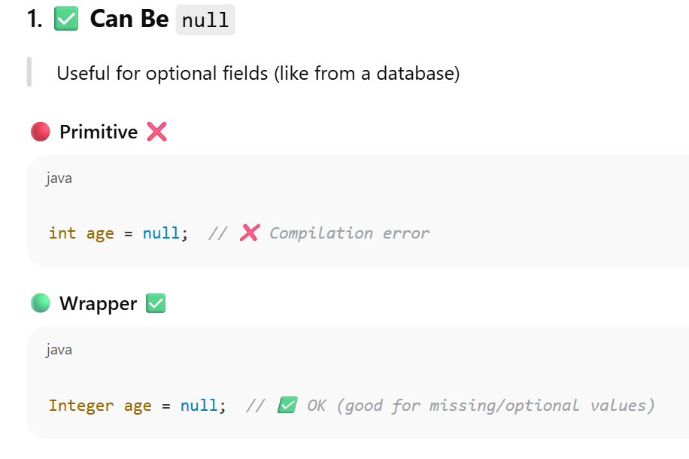

Slide 21
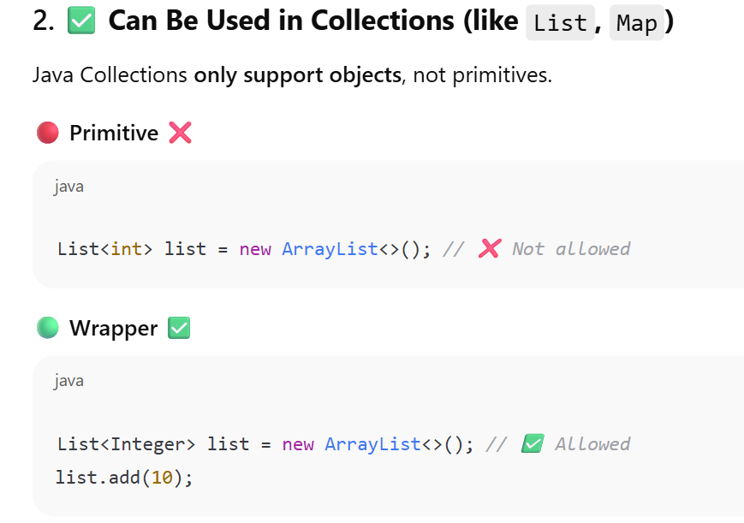

Slide 22
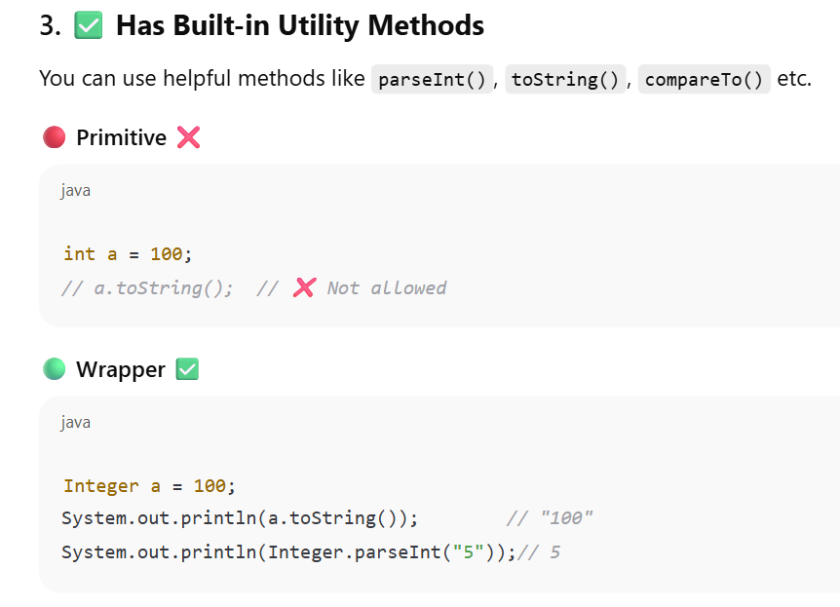

Slide 23
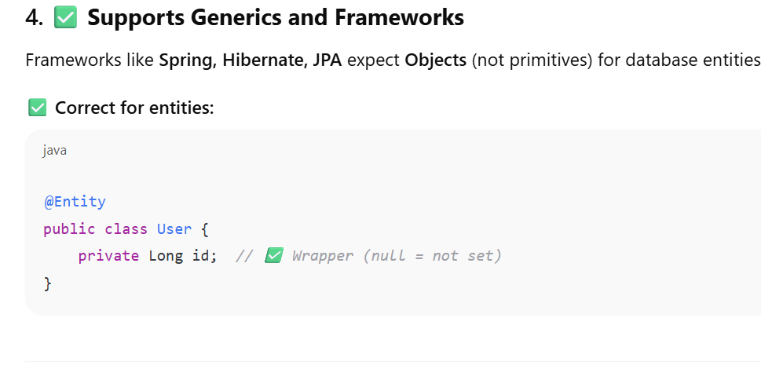

Slide 25

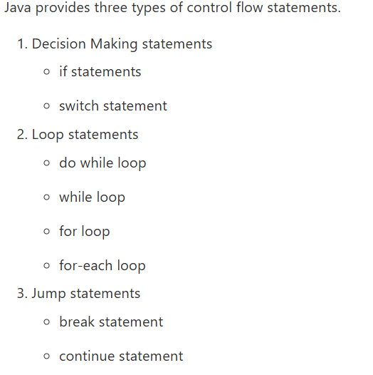

Slide 26
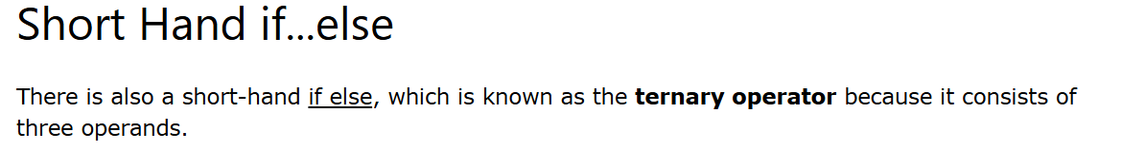


Slide 27
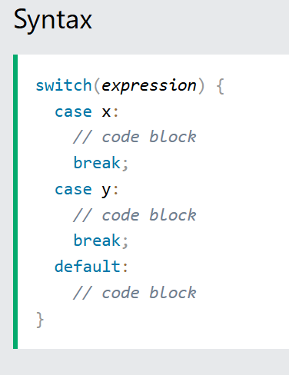

Slide 28
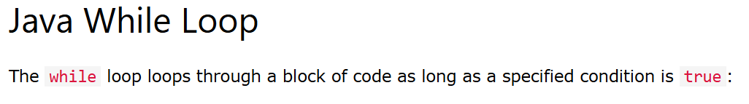
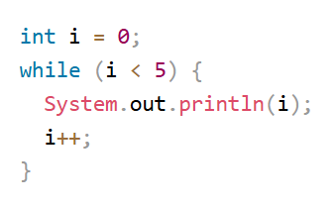
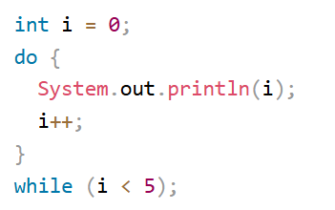

Slide 29

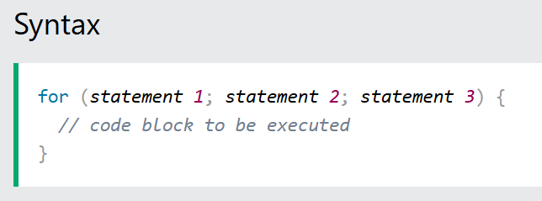
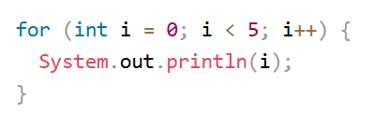

Slide 30
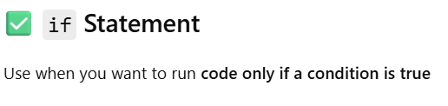
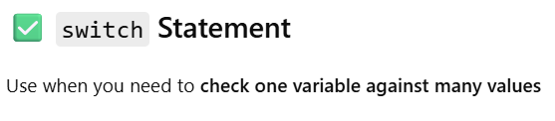
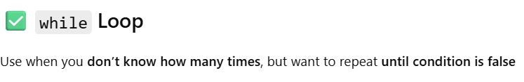
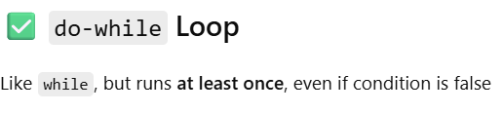
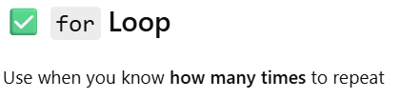

Slide 31
.nextInt();
.nextDouble();
.next(); // stops at space
.nextLine();
.next().charAt(0); // reads first character of input
.charAt(i);
.nextBoolean();

Slide 32
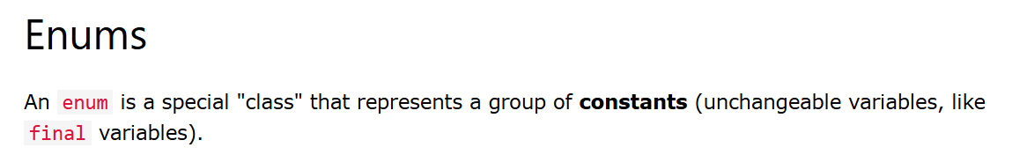
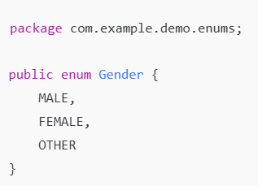

Slide 33
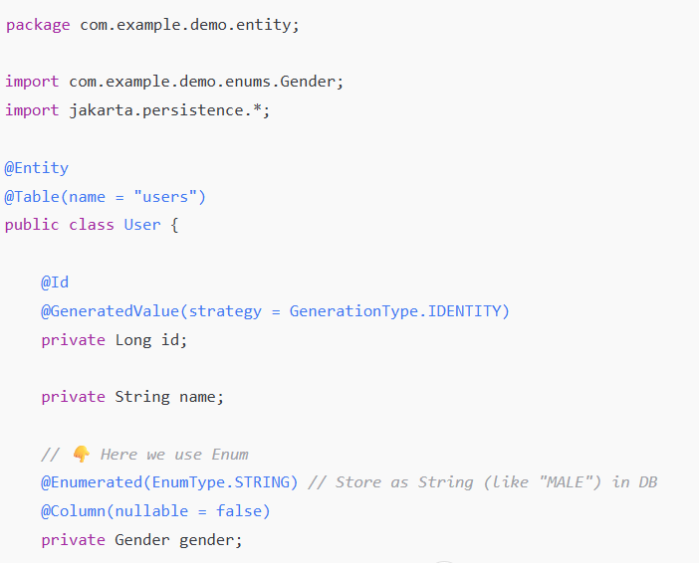

Slide 34
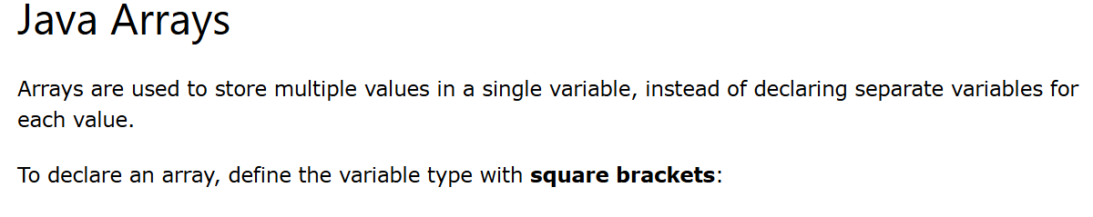

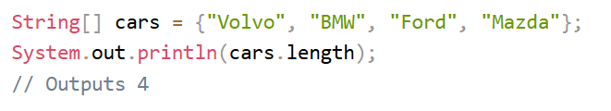

Slide 35
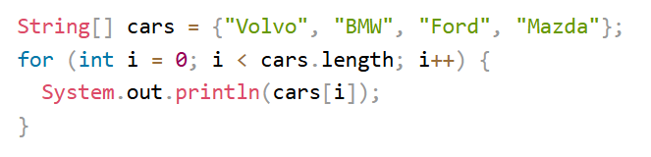
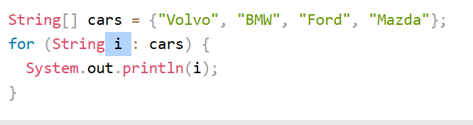

Slide 36
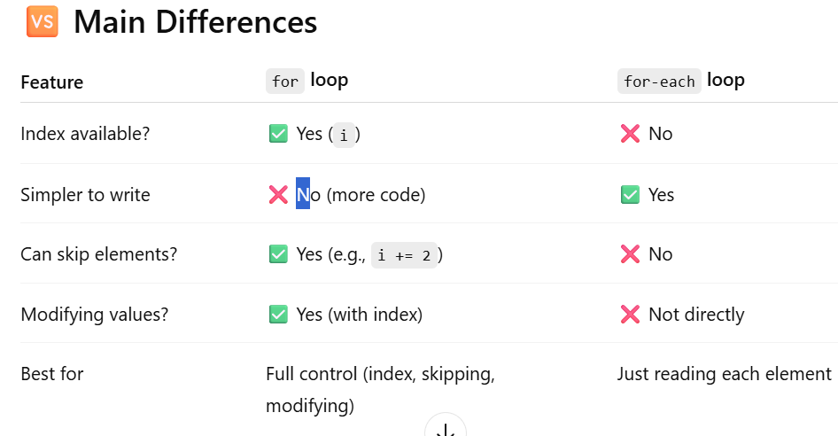

Slide 37
Reading Elements from user in arrays and printing

Slide 38

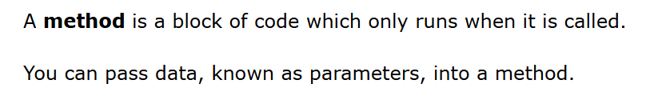
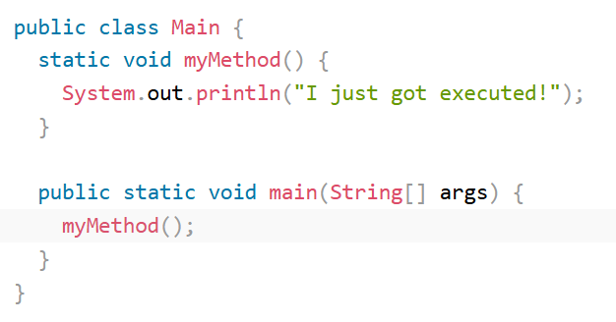
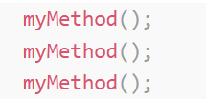

Slide 39

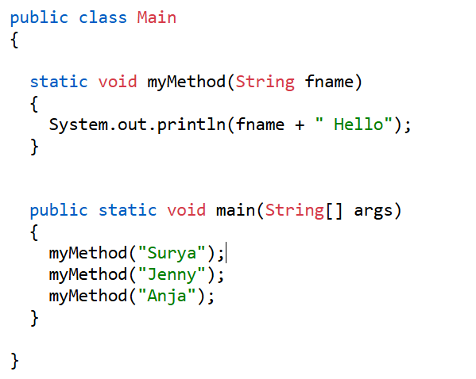

Slide 40
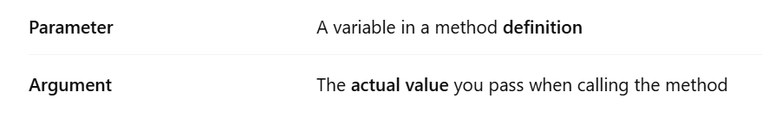

Slide 41
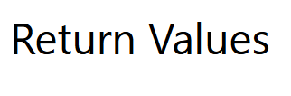
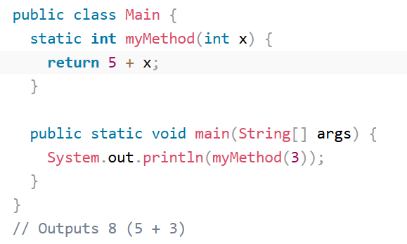

Slide 42

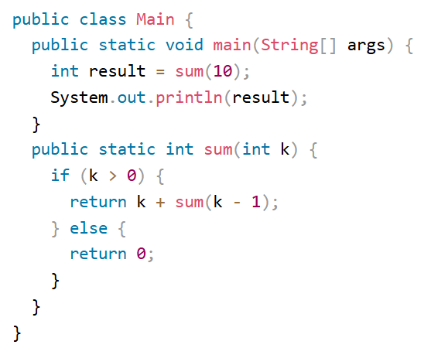

Slide 43
